Slide 1

Modeling Strategies Assignment & Supervised ML
Xu Feng

Slide 2
Modeling Strategies Assignment Discussion
Step 1
EDA
Step 2
Feature Engineering
Step 3
Under/Oversampling
Step 4
Random Forest

Slide 3
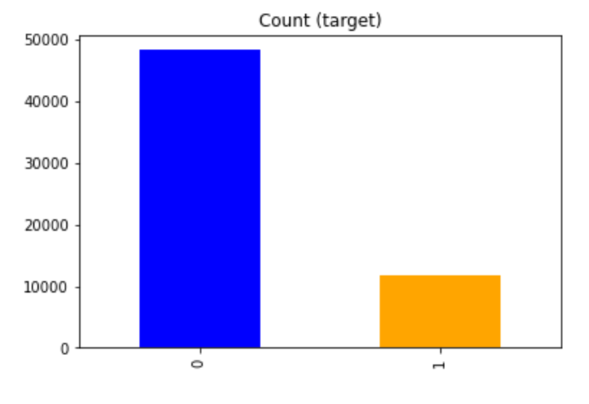
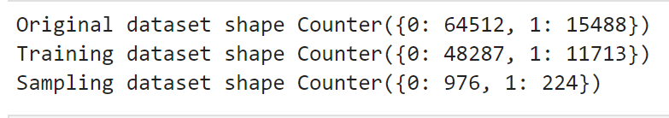
Under/Oversampling
What is an imbalanced dataset and how to solve it?
- The issue of class imbalance can result in a serious bias towards the majority class, reducing the classification performance and increasing the number of false negatives. How can we alleviate the issue? The most commonly used techniques are data resampling either under-sampling the majority of the class, oversampling the minority class, or a mix of both. This will result in improved classification performance.
Order matters
- We should perform under/over sample (including SMOTE) only on training data, and measure f1 on original data distribution (test data). Moreover, if we divide oversample data with train_test_split, we have no control over the distribution of duplicated items for test and train. This means that you can have the same observation in both test and train, which means you test partially on the training set - that's why the results increase. So first divide into train/test, and then perform operations only on the training set, and the test set should be without any changes.

Slide 4
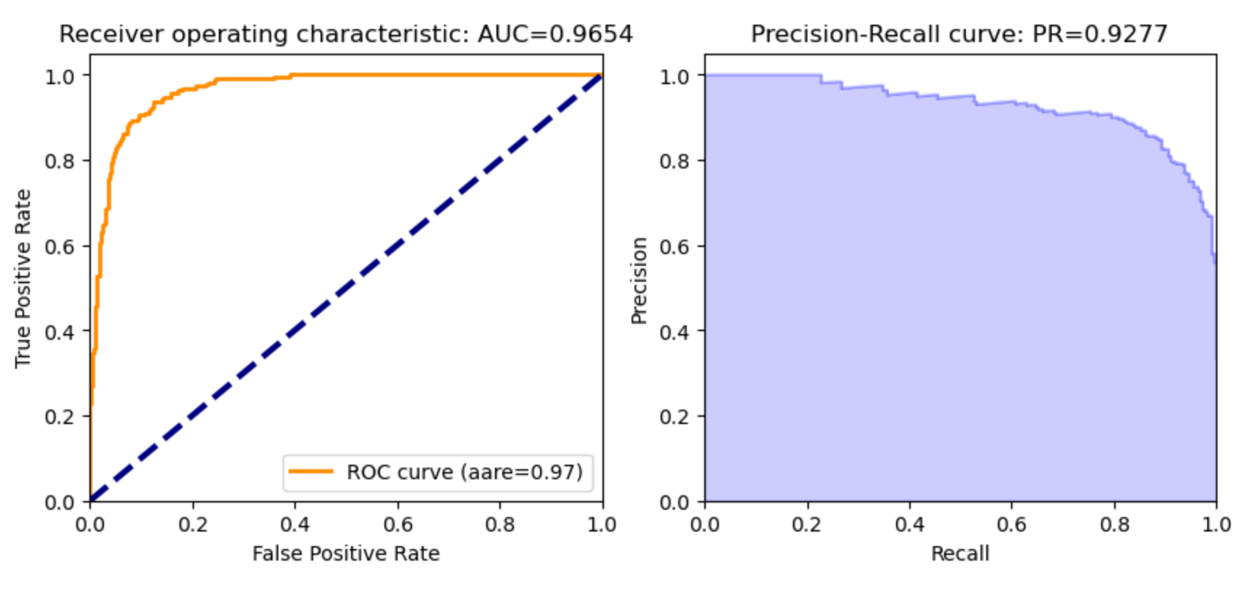
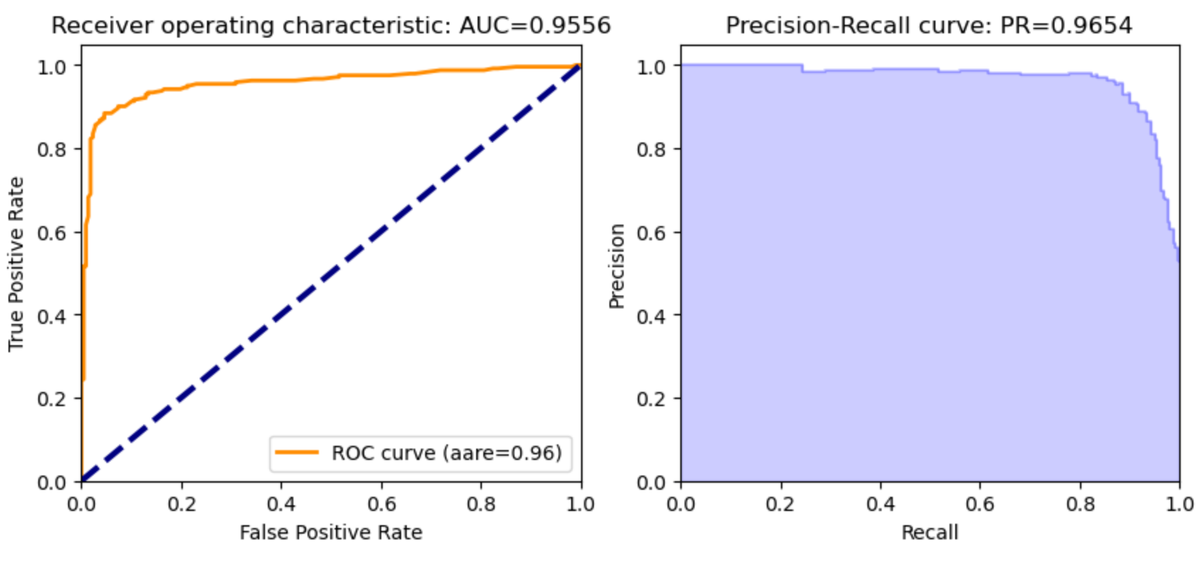
Random Forest
Random forest is an ensemble learning method for classification, regression, and other tasks that operates by constructing a multitude of decision trees at training time. In other words, random forest is sampling features from bagging. For classification tasks, the output of the random forest is the class selected by most trees.
Under-sampling
Over-sampling

